Slide 1


The Fine Tuners
14.11.2023
Presented by M.Cem Akuras

Slide 2

Table of Content
Introduction
01
02
Data Understanding
Data Structure
Column Analysis
Missing Values
Duplicates & Outliers
Data Preparation
03
XXXX
ETL Process Enhancements at a Glance
Before and After ETL
04
Summary
Next Steps
05

Slide 3

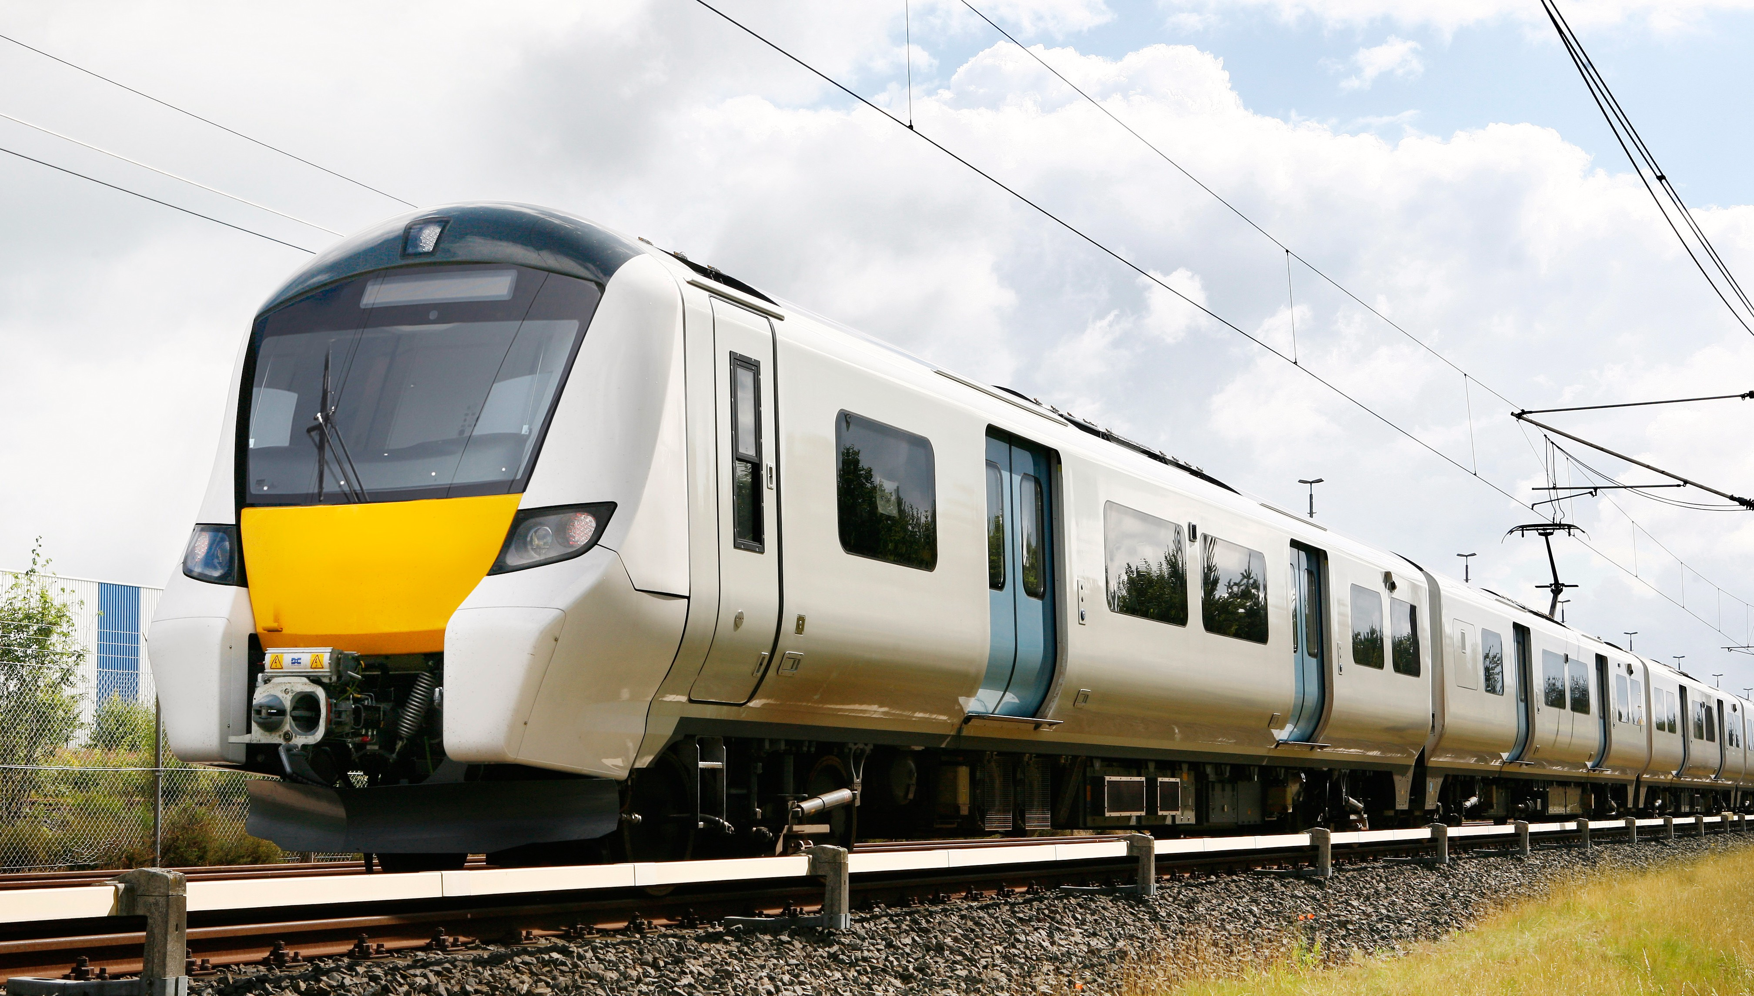
Introduction
Presentation Purpose : Delve into the critical stages of Data Understanding and Data Preparation for our project focused on enhancing Train Maintenance through NLP Analysis of Social Media Tweets.
Effective data understanding and preparation are the keys to ensuring the quality and accuracy of the data we use in our analysis, which is vital for making informed decisions and improving train maintenance.

Slide 4







Data Understanding Data Structure
Data Sources
Data Format
2 different sources
JSON File
Data Quality
Data Size
2,219 Duplicates
3 columns have missing values
16,949 Rows
20 Columns
Data
Data Types
1 Date/Time
4 Categorical
8 Numeric,
1 String
6 Constant
Flat File
Data Organisation

Slide 5
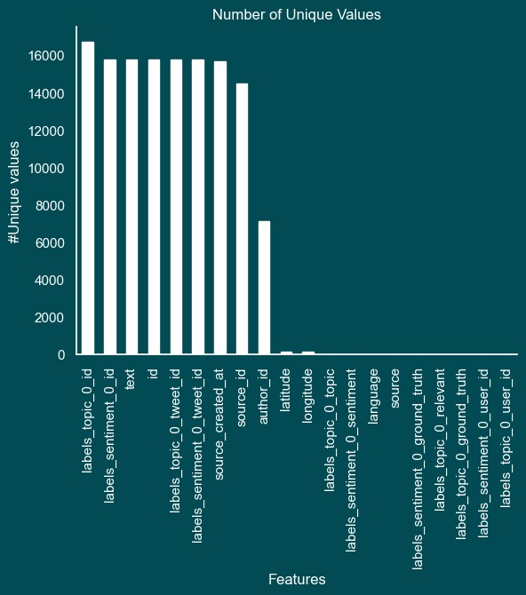
Data Understanding Column Analysis
The dataset size of 16,949 tweets provides a substantial volume for the analysis.
The dataset comprises a variety of columns, including text, timestamps, and other relevant information.
Columns with star which are ‘text’, ‘author_id’, ‘labels_sentiment_0_topic’, ‘source_created_at’ ‘labels_topic_0_topic’ and ‘source’ take center stage in our analysis, signifying our focus.

Slide 6
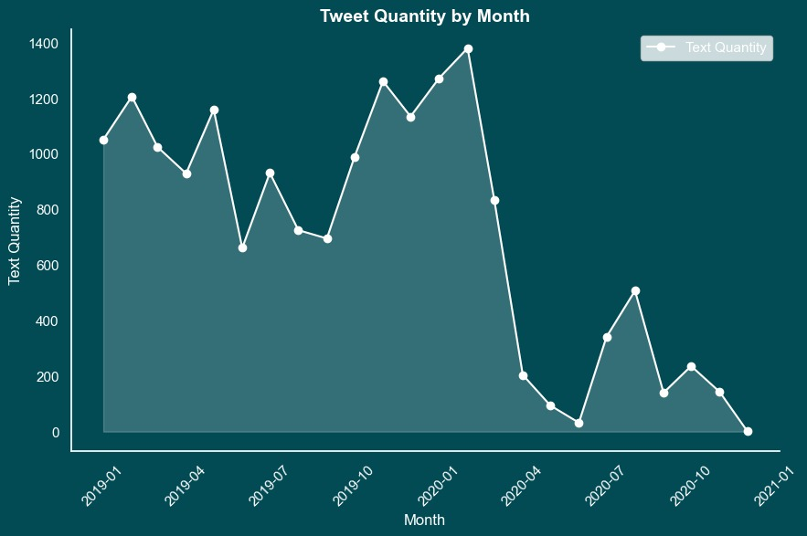
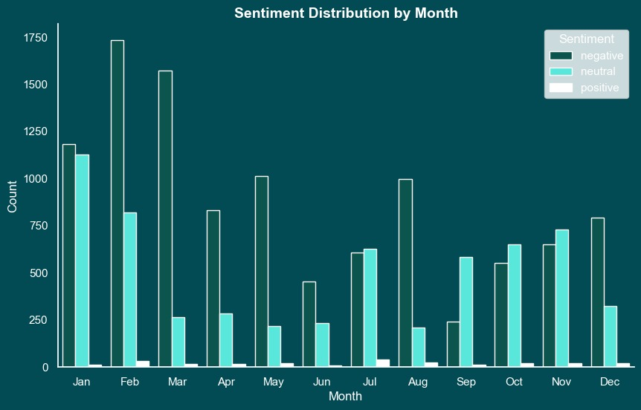
Data Understanding Time
The dataset covers a time interval from the beginning of 2019 to the end of 2020.
The graph shows how sentiments evolved month by month alongside tweet quantity.
Notes:
The dataset covers a time interval from the beginning of 2019 to the end of 2020.
In addition to tweet quantity, the sentiment distribution was also examined month by month. This graph provides insights into how sentiments evolved within the dataset over the same time frame.

Slide 7
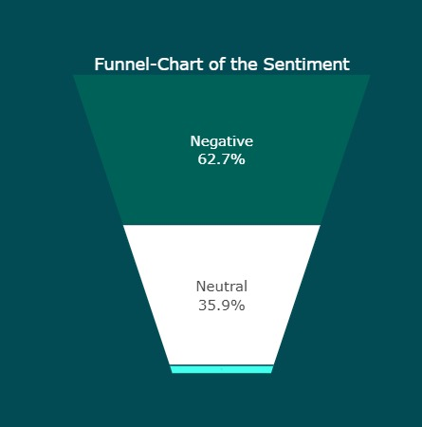
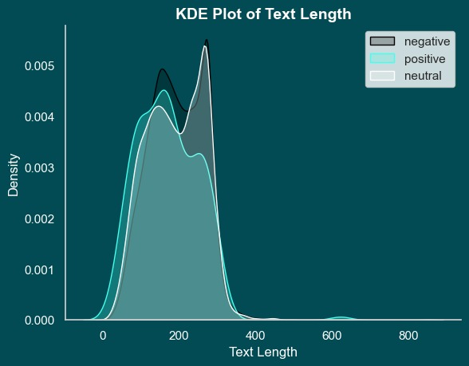
Data Understanding Sentiment
The dataset's 'Sentiment' column classifies tweets into negative, positive, or neutral sentiments.
There exist a trend where negative sentiments align with longer text posts.
Positive
Notes:
The dataset includes sentiment annotations in the form of a 'Sentiment' column, categorizing tweets into negative, positive, and neutral sentiments.
Our analysis reveals a notable trend where negative sentiments align with longer text posts. This suggests that individuals tend to express anger and frustration through more extensive, detailed, and expressive tweets.

Slide 8
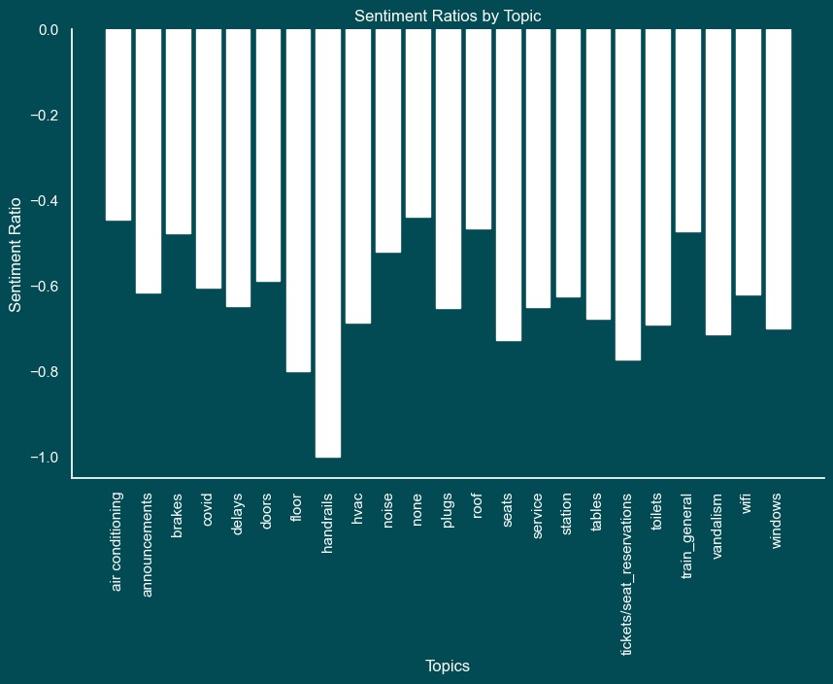
Data Understanding Sentiment
Chart shows average sentiment on various topics and provides insight into sentiment differences by topic
Notes:
This graph presents the average sentiments (positive, negative, and neutral) for various topics within the dataset, offering insights into how sentiment varies across different topics.

Slide 9
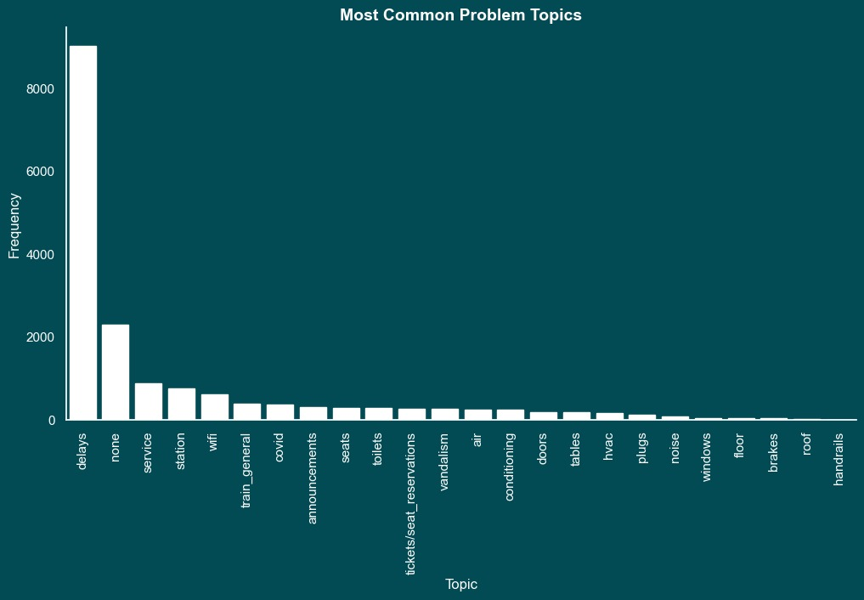
Data Understanding Topic
The dataset includes tweet topic annotations for classification and analysis.
Notes:
The dataset includes categorical annotations for tweet topics, allowing us to classify and analyse tweets based on their respective subjects or themes.

Slide 10
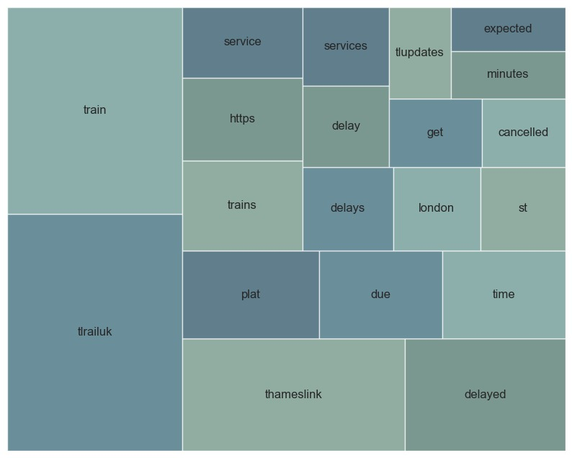
Data Understanding Text
Visualization of frequently used words, provides insights into major topics on social media by highlighting key terms and dominant themes in tweets.
Graph includes variations of the most common topic "delay": "delay", "delays", and "delayed".
Notes:
Our analysis also includes a visualization of the most frequently used words within the dataset. This graph highlights the key terms and themes that dominate the conversation, offering valuable insights into the central topics and discussions as observed in social media tweets.
As the most common topic, 'delay' appears on this graph in three variations: 'delay’, 'delays’ and 'delayed’. We will address this redundancy in the data preparation process to ensure accurate and consistent analysis.

Slide 11
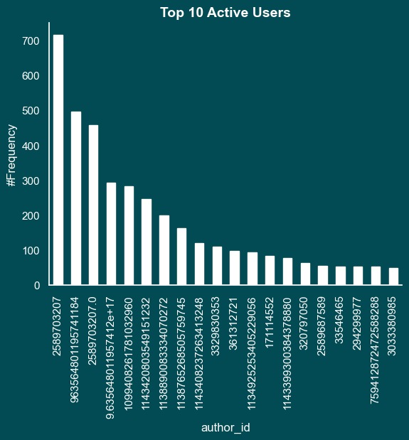
Data Understanding Author ID
The chart shows the top 10 active users. Stars indicate accounts that posted similar tweets that serve as communications for the company.
Notes:
This graph showcases the top 10 most active users in our dataset. Notably, users denoted with yellow stars have consistently used the hashtag #TLUpdates, while those with red stars have frequently employed the hashtag #ThameslinkUpdate. These tweets, identified as company communications, provide official updates and communications from the company.

Slide 12
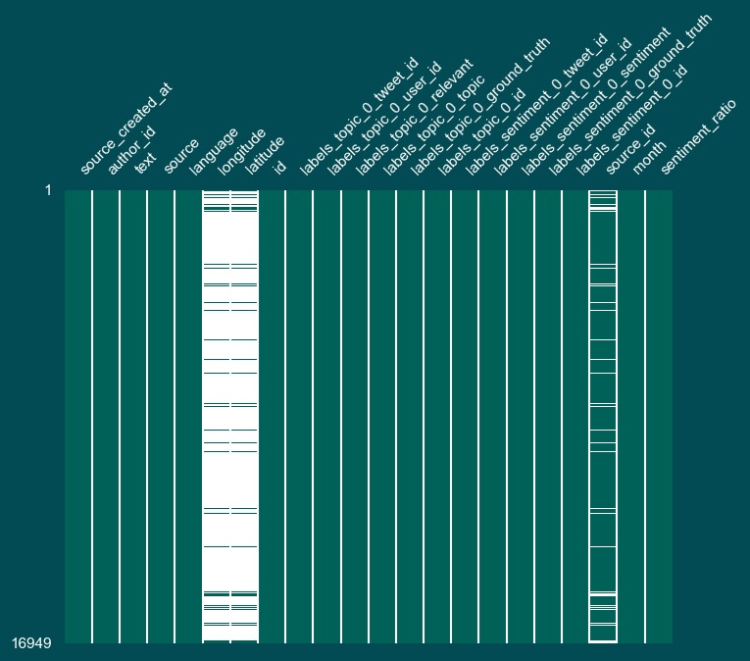
Data Understanding Missing Values
Missing values were identified in three columns in the dataset. In two columns missing values do not aid meaningful analysis.
Two columns do not provide actionable information to the analysis and will be removed in the future steps.
Notes:
In our dataset, we have identified missing values in three columns: Longitude, Latitude, and Source ID. These missing values are notable in the Longitude and Latitude columns, but they are not conducive to meaningful analysis as they represent GPS coordinates.
Given that the Longitude and Latitude columns contain missing values and do not provide actionable insights for our analysis, we will exclude them from our data processing, ensuring a focus on more relevant features.

Slide 13
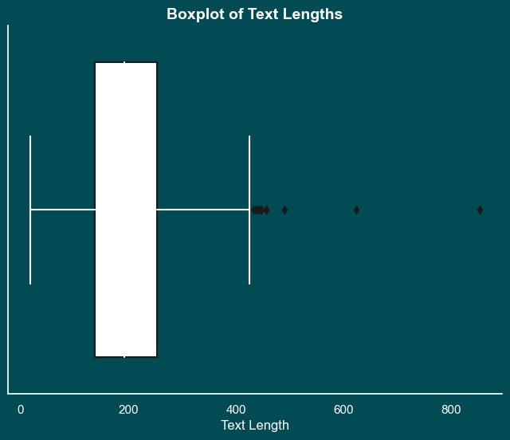



Data Understanding Duplicates & Outliers
We've identified 2,219 duplicate entries, 388 highly similar rows (90% - <100%), and 37 retweets. Identifying and addressing these duplicates is crucial to ensure the integrity of our analysis and insights.
The box plot highlights 11 outliers in text length within our dataset, with a maximum value of 400.
11 outliers in text length
388 similar rows
(90% - <100%)
2,219 duplicates
37 retweet

Slide 14
Data Preparation
The entire dataset utilized, without limiting the analysis to a specific time range, region, or subset, in order to comprehensively explore all available data.
Our team is currently in the evaluation stage regarding the potential use of the Twitter API to acquire additional datasets.

Slide 15
Data Preparation ETL Process Enhancements at a Glance
Findings/Problems | Decision | Impact
Unreadable Column Names | Shorten and Standardize | Improved Data Clarity
Data Types | Fixed Data Types | Enhanced Data Consistency
Redundant Time Information | Remove Second and Millisecond Information | Reduced Data Volume and Improved Data Quality
Singleton and Junk Columns | Removed 14 Columns | Simplified Data Structure and Reduced Data Redundancy
Duplicate Rows Based on Text Column | Removed 2,219 Rows | Enhanced Data Relevance for Maintenance Improvements

Slide 16
Data Preparation ETL Process Enhancements at a Glance
Findings/Problems | Decision | Impact
Similar Rows (>90%, <100%) | Removed Rows | Enhanced Data Quality
Outliers Based on Tweet Length | Removed 11 Rows | Improved Data Quality and Analysis Accuracy
Tweets Sent by Thameslink Accounts | Removed 9 Authors | Enhanced Data Purity and Content Relevance
Common Words | Removed 14,517 Common Words | Enhanced Text Analytics and Data Insights
Delay Related Topics | Removed 9,023 Rows (53% of Raw Data) | Reduced Noise and Enhanced Data Relevance
6419 rows x 6 columns left

Slide 17
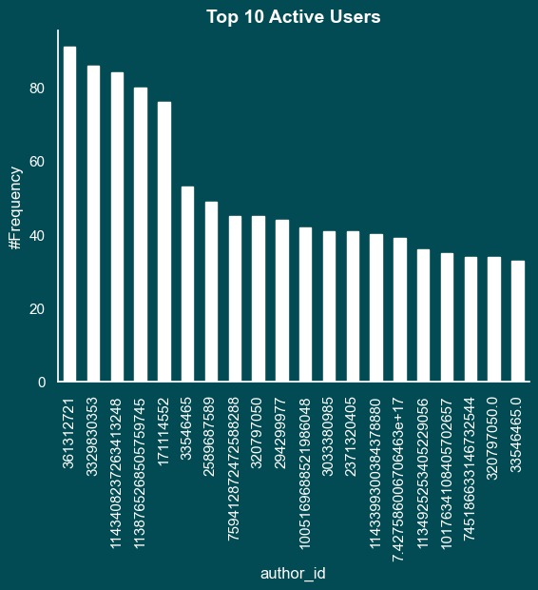
Data Preparation Before and After ETL

Slide 18
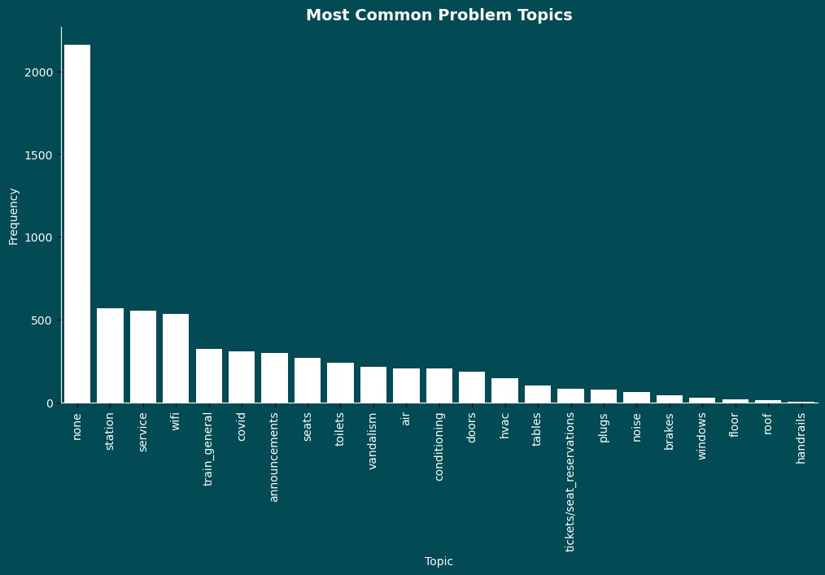
Data Preparation Before and After ETL

Slide 19
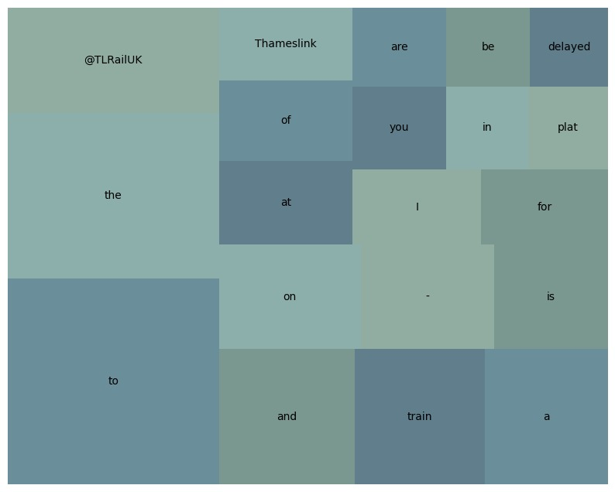
Data Preparation Before and After ETL

Slide 20
Summary
Described the data structure and checked for annotations.
Assessed data quantity, distributions, representation, and addressed any gaps.
Chose to use the complete dataset for analysis and investigated the availability of supplementary data to enhance the analysis.
Handled missing values in the dataset.
Identified and removed outliers from the data.
Clarified the logic behind the decisions made in data preparation and analysis.

Slide 21

Next Steps
Removing tweets with positive sentiment.
Start with data preprocessing – stemming , lementization , entity extraction etc.
Take a pretrained classification model and finetune to get the complaints and non-complaints.
Feed the tweets to ChatGPT or any LLM model to get actions to fix the issue.

Slide 22
Thank you!

